Slide 1
Data Challenge B
Data-driven Customer Success
Wei Zhang, Xiao Liu, Tianxing Ma, Shaocong Peng, Yi Wang, Zhu Wang

Slide 2
Descriptive Data

Slide 3
Descriptive Data
Case Study
Actionable Advices
Demographics of Learnta member school
Number of teachers, students per school
Geographical distribution of Learnta member schools
Daily, weekly, monthly active users (students and teachers)
Time spent on Learnta system per student per week
Time from becoming Learnta member school to active
Daily, weekly, monthly active users (students and teachers)
Frequency of using Learnta system
Time spent on Learnta system per student per week
Classification of learning activity, in-class learning or after-class learning
Define the active degree of the school
Access the teaching quality of the school
Develop the vital signs for the school
Analyze the relationship between engagement in Learnta system and learning outcomes
Actionable advices to make Learnta member schools active
Actionable advices to improve recurring revenue
CONTENTS

Slide 4
Case Study

Slide 5
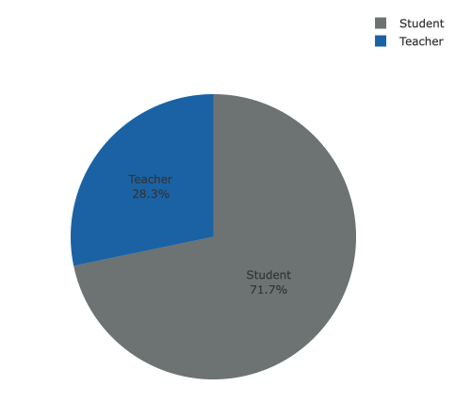
Organization 100082

Slide 6
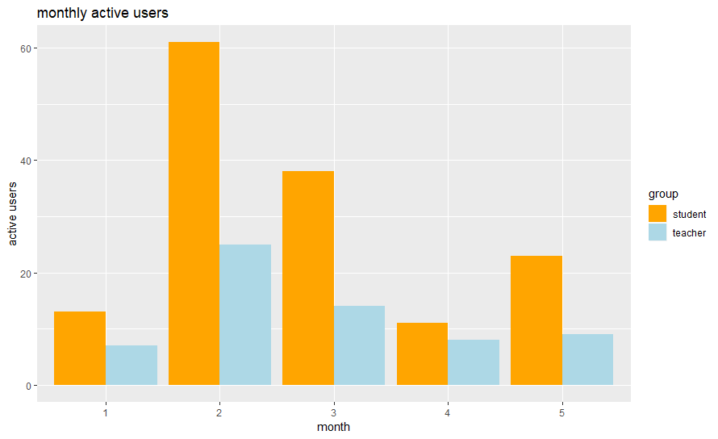
Daily, Weekly, Monthly Active Users
For Monthly Data

Slide 7
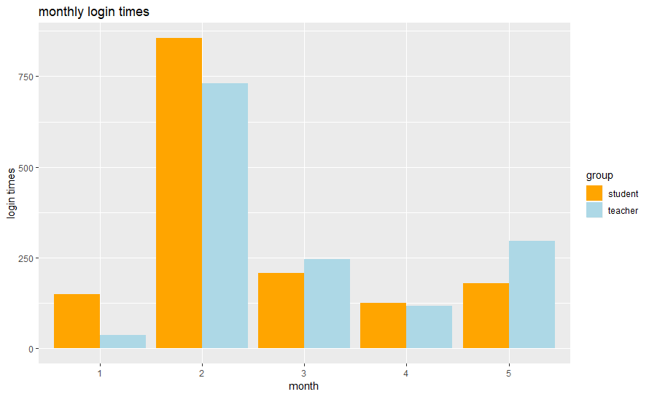
Daily, Weekly, Monthly Active Users
For Monthly Data

Slide 8
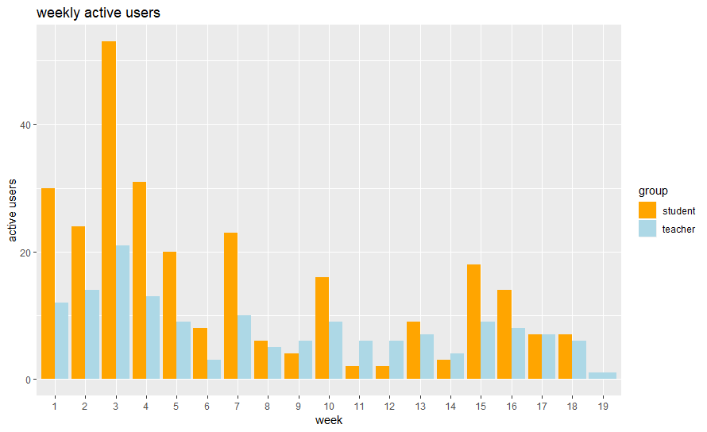
Daily, Weekly, Monthly Active Users
For Weekly Data

Slide 9
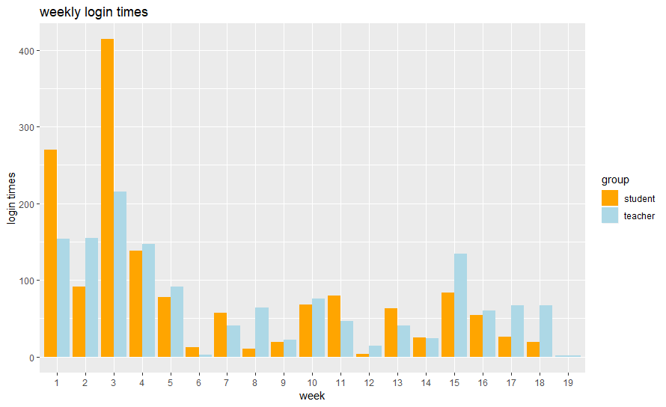
Daily, Weekly, Monthly Active Users
For Weekly Data

Slide 10
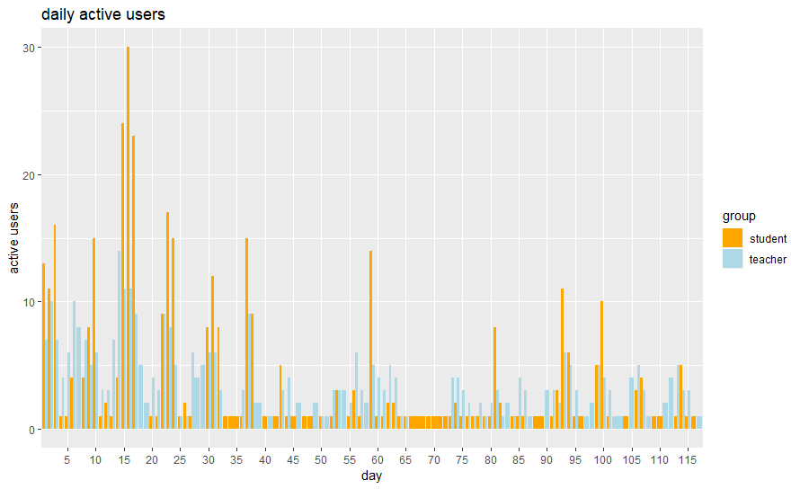
Daily, Weekly, Monthly Active Users
For Daily Data

Slide 11
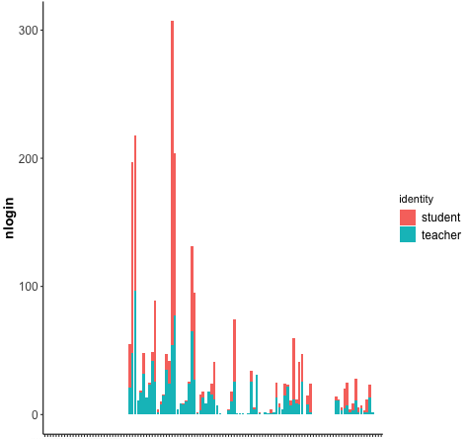

Daily, Weekly, Monthly Active Users
Daily Login Number

Slide 12
Daily, Weekly, Monthly Active Users
Conclusion:
The main trend of user actives is decrease.
Dec 2019 have the most active users.
Data fluctuates greatly during different time periods.

Slide 13
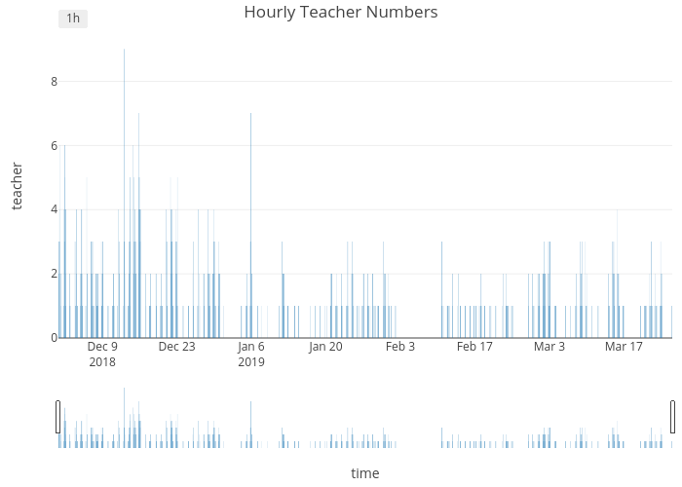
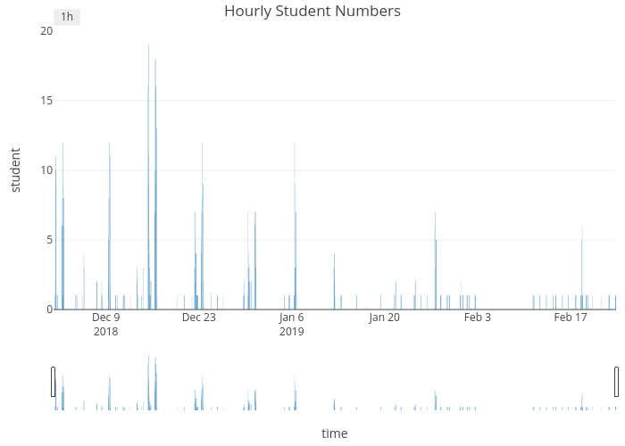
Frequency of Using Learnta System
Hourly Student & Teacher Numbers

Slide 14
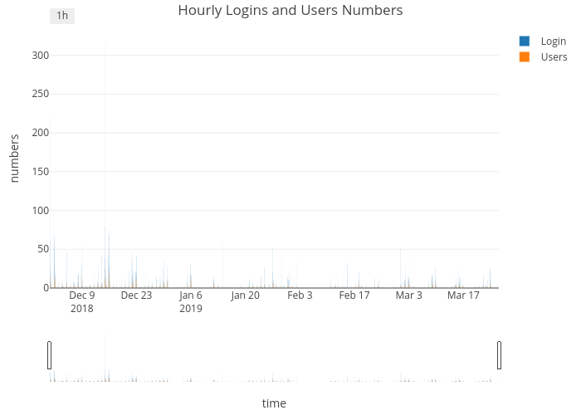
Frequency of Using Learnta System
Hourly Total Numbers

Slide 15
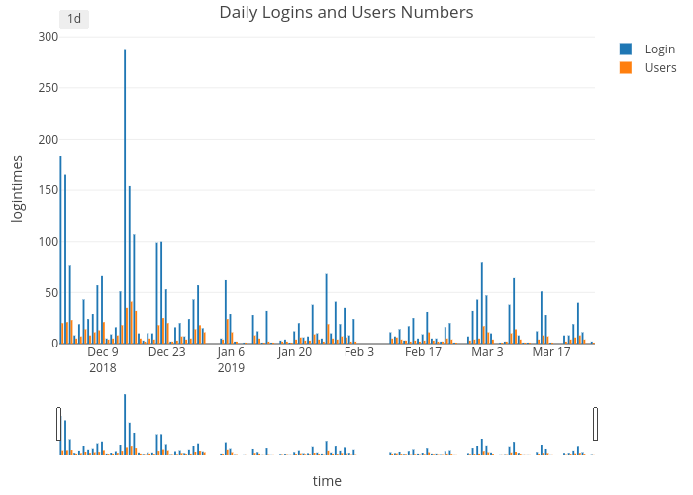
Frequency of Using Learnta System
Daily Logins and
Users Numbers

Slide 16
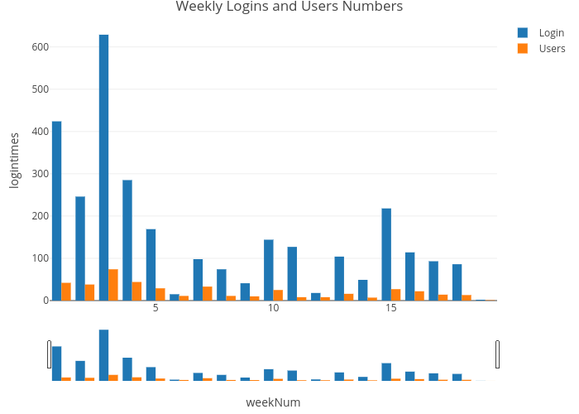
Frequency of Using Learnta System
Weekly Logins and
Users Numbers

Slide 17
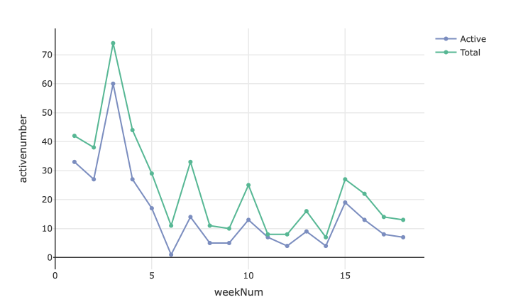
Active Degree
Weekly Active Users
(Logintimes > 2)

Slide 18
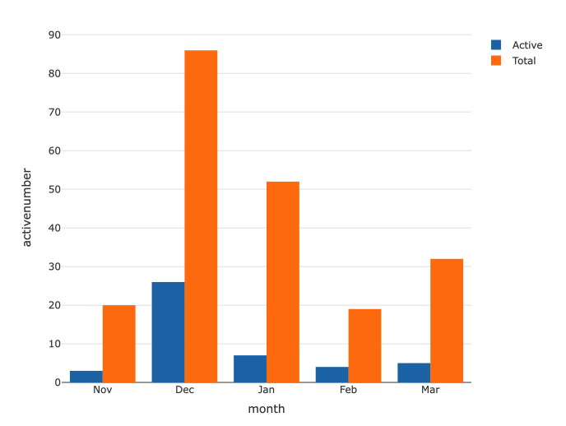
Active Degree
Monthly Active Users

Slide 19
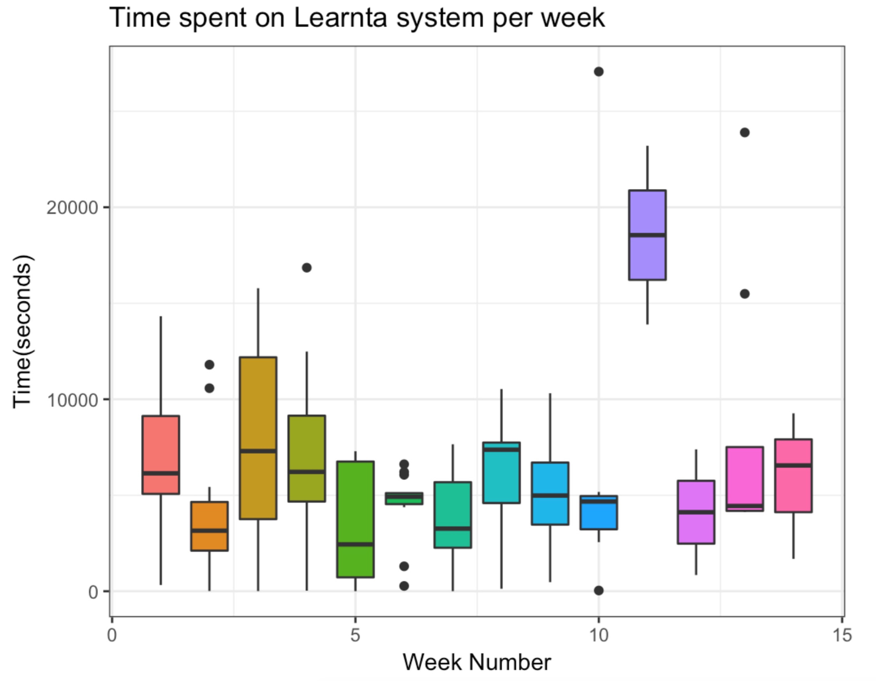
Time Spent on Learnta System per Student per Week

Slide 20
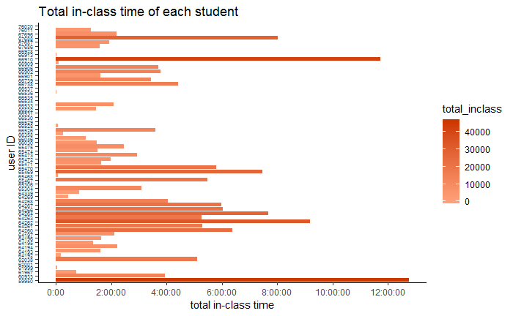
Classification of learning activity
Mean: 2:43:50
SD: 2:58:44
Quantile:
0% 0:00:00
25% 0:06:49
50% 1:38:46
75% 4:01:34
100% 12:45:56

Slide 21
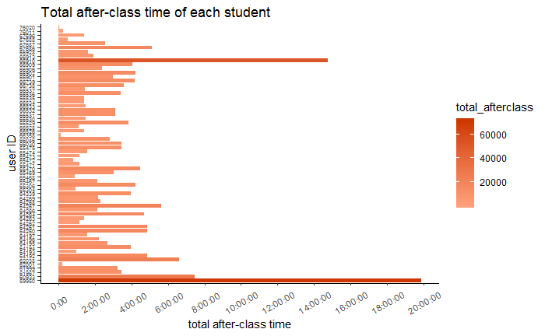
Classification of learning activity
Mean: 3:06:28
SD: 3:07:02
Quantile:
0% 0:01:45
25% 1:24:18
50% 2:27:48
75% 3:57:18
100% 19:52:29

Slide 22
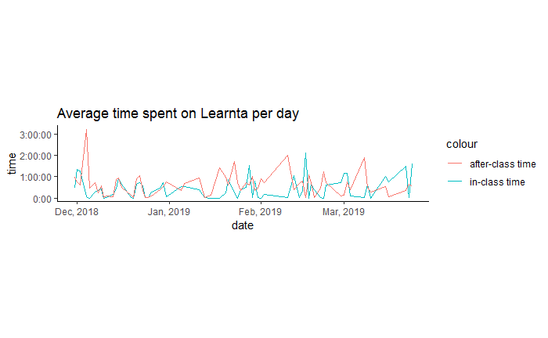
Classification of learning activity

Slide 23
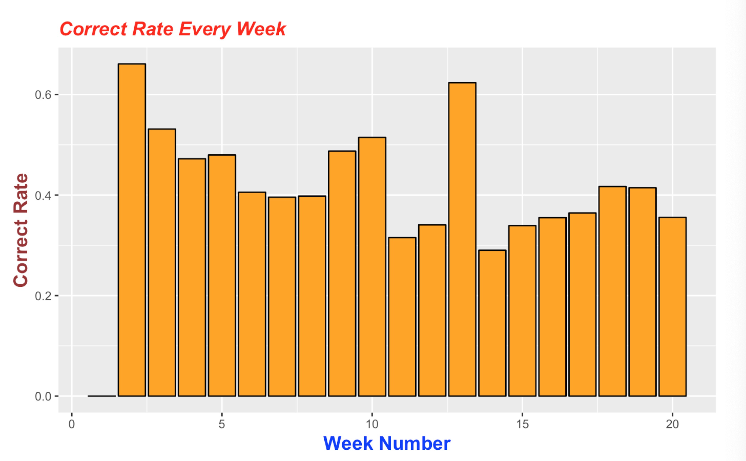
Teaching Quality

Slide 24
Vital Sign
Customer health scores are a great way to get an indicator of potential customer churn.
Step 1
Categorize
Step 2
Weigh
Step 3
Measure
Active level:
number of active users, frequency of using the system, time spent on the system, ......
Customer feedback:
teaching quality, technical support, ......
Weigh
Doing Well
Take Notice
Needs Attention!

Slide 25
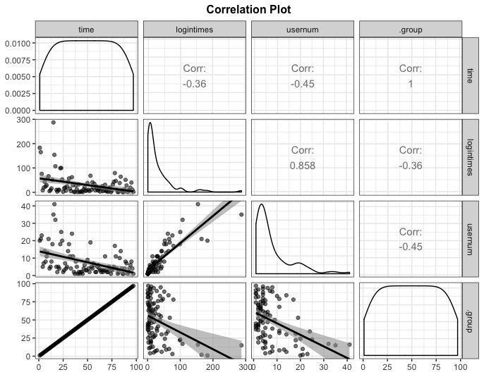
Vital Sign
Correlation

Slide 26
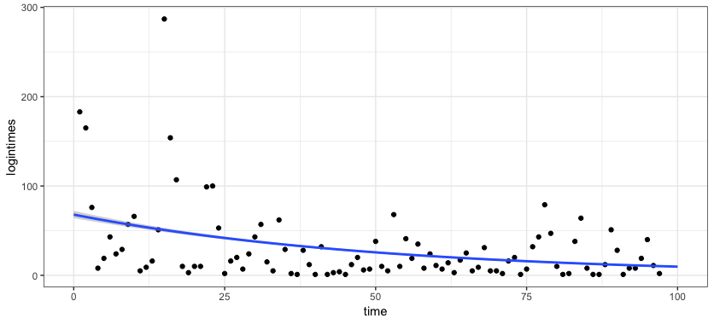
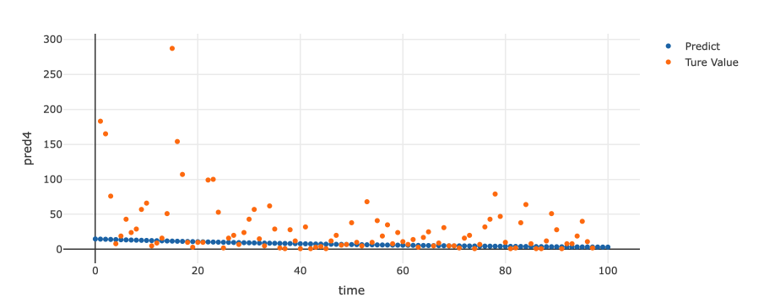
Model Building
Daily Login Times
Poisson Regression
Negative Binomial
Regression

Slide 27
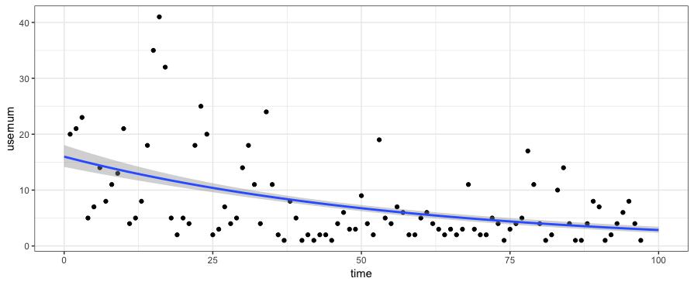
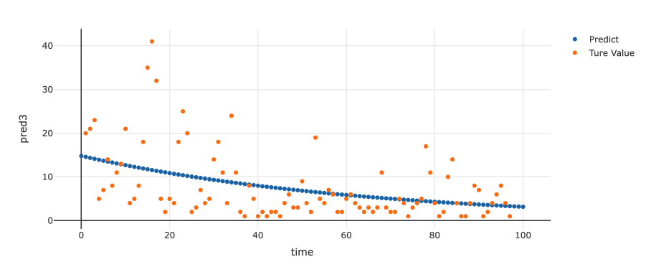
Model Building
Daily Users
Poisson Regression
Negative Binomial
Regression

Slide 28
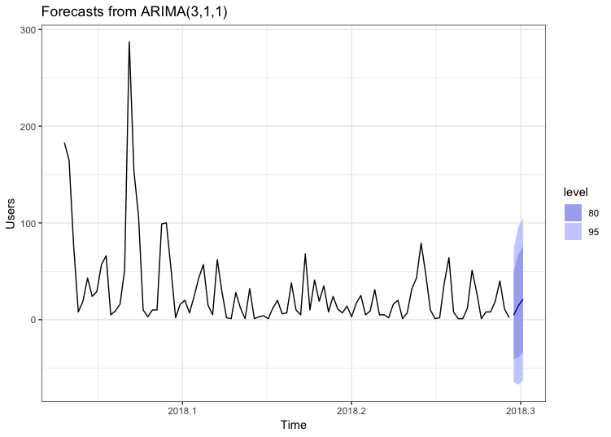
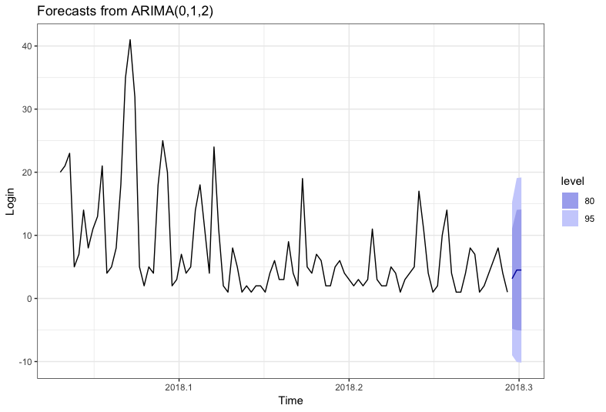
Model Building
ARIMA
Daily Logins
Daily Users

Slide 29
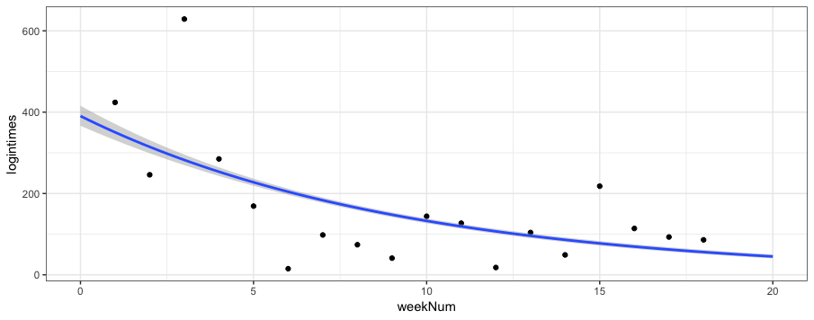
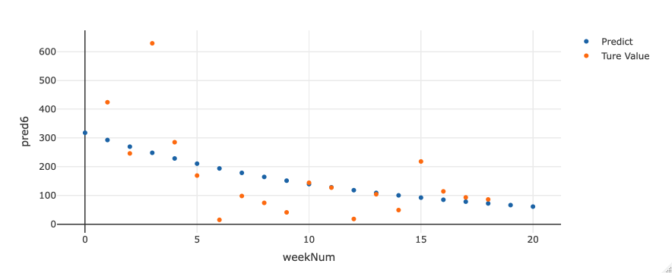
Model Building
Weekly Login Times
Poisson Regression
Negative Binomial
Regression

Slide 30
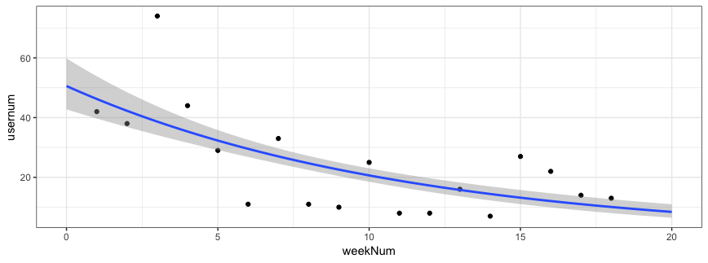
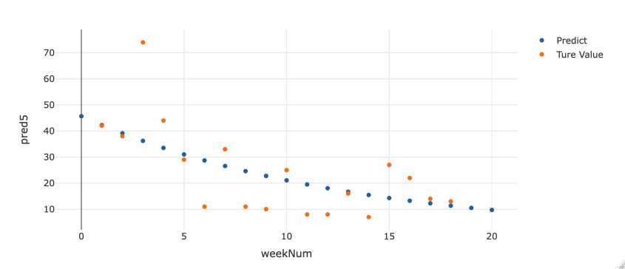
Model Building
Weekly Users
Poisson Regression
Negative Binomial
Regression

Slide 31
Actionable Advices

Slide 32
Thank you!

